Slide 1
Lending Club Case Study
Presented By:
Retheesh Ravi
Pavan Kale

Slide 2
Data Understanding, Cleaning and Manipulation
There are 54 columns having all NaN values, dropped those
Dropped single value column: policy_code, application_type, acc_now_delinq, delinq_amnt, initial_list_status, pymnt_plan
Dropped other column which has no meaning in analysis or have 0 and NA values only: member_id, url, desc, collections_12_mths_ex_med, chargeoff_within_12_mths, tax_liens, next_pymnt_d
Drop rows having loan_status=Current as we are interested in loan_status=Charged Off/Fully Paid only
No duplicate rows in data
No rows with all NaN values
Delete rows have emp_length=NA values as this variable impact customer income and cannot fill with average or 0 value
Change emp_length column from object type to int
Change int_rate column from object type to int
Extract month and year from all date columns: issue_d, earliest_cr_line, last_pymnt_d, last_credit_pull_d
Change revol_util column from object to int
annual_inc column have outliers, drop rows having value more that 95% percentile
revol_bal column has large number of outlier, drop rows having value more that 95% percentile
Add new column ChargedOff, 1 if loan_status=Charged Off else 0

Slide 3
Unordered Categorical Variables - Univariate Analysis
Note: Following analysis is after cleaning the data
home_ownership
Around 50% people are leaving in rented house, and they are buying the first home.
Less than 5% of people already have their own home and going for second (or more) buy
verification_status
From all the charged-off borrowers, 45% are not “Not Verified”. Out of those 12.5% are charged off, so verification of borrower is the crucial factor to avoid charged off.
purpose
Around 27.5% of the customer who have taken loan for “small_business” are charged off. So, purpose of loan is the crucial factor to avoid charged off. Out of these around 33% are not verified
Around 20% of the customer who have taken loan for “renewable_energy” are charged off, out of those 47% are not verified.
Around 50% of the customers have taken loan for “debt_consolidation”
So are should be taken while providing loan for small_business and renewable_energy
addr_state
Around 19.6% of the total customers are from state “CA”
20.7% of the total customers from state “NV” are charged of, so special care must be taken while providing loan to this state customers

Slide 4
Ordered Categorical Variables - Univariate Analysis
Note: Following analysis is after cleaning the data
term
Around 75% of the customer take loan for 36 months
Around 26% of the customer who have taken load for 60 months are charged off, so longer the duration of loan higher chance of being charged off
grade
Around 30% of the customers are of grade B (B > A > C > D > E > F > G).
grade vs frequency of grade (not log of frequency of grade) graph follow ‘Power Law Distribution’
If we assume A as the highest grade of the customer and G as lowest grade of the customer, lower (E, F, G) the grade of the customer, there is high chance of charged off.
Around 37% of the grade G customer are charged off, 32.5% of the grade F customer are charged off and 27% of the grade E customer are charged off
sub_grade:
sub_group have characteristics like grade
emp_length
21% of the total customers are having 10+ years of employment length
15.5% of 10+ years emp_length are charged off and 4% are still paying loan so some of those may charged off. So, care should be taken while providing loan to high emp_length (age) customers
delinq_2yrs
10% of customer have failed at least once incidences of delinquency.
delinq_2yrs plot follow ‘Power law distribution’
Continue…

Slide 5
Ordered Categorical Variables - Univariate Analysis
Note: Following analysis is after cleaning the data
inq_last_6mths:
More than 50% of the customer have at least one inquiry in last 6 months
inq_last_6mths plot follow ‘Power law distribution’
As the number of inquiries increases, number of customers getting charged of increases
inq_last_6mths = 7 0r 8 (around 28.5-30% are charged off)
inq_last_6mths = 6 (around 21% are charged off)
pub_rec:
Around 5.5% of the customer have derogatory public records
pub_rec plot follow ‘Power law distribution’
If customer has public derogatory record, then there is high chance (around 22%) of charged off (ignore pub_rec=3 or 4 as number of records are very less)
pub_rec_bankruptcies:
4.5% of the customer have public record of bankruptcies
pub_rec_bankruptcies plot follow ‘Power law distribution’
As the number of public record of bankruptcies increases, chance of charged off increases
pub_rec_bankruptcies = 2 (40%)
pub_rec_bankruptcies = 1 (22%)

Slide 6
Quantitative/Numeric Variables - Univariate Analysis
Note: Following analysis is after cleaning the data
loan_amnt
If we divide the loan amount into bins of 5000 and check loan_status, as loan amount increases, chance of getting charged off increases
Around 33% of the customer took loan in between 5000-10000
int_rate:
If we divide the loan amount into bins of 5 and check the loan_status, as interest rate increases, chance of customer getting charged off increases
annual_inc:
Avg income varies from 40000 to 60000
Higher the annual income of customer, less chance of getting charged off
revol_bal and revol_util:
Higher the value of revol_bal or revol_util, higher chance of customer getting charged off

Slide 7
Recommendations
verification_statue: Borrower should be verified before providing loan.
purpose: If purpose of the loan = small_business or renewable_energy, then special care should be taken while providing loan as there is high chance of getting charged off
addr_state: If borrower addr_state is NV or FL then there are chances of charged off
grade: If we consider A being highest and G being lowest grade; lower the grade, high chance of customer getting charged off
revol_bal and revol_util: higher the value of revol_bal and revol_util for customer, high chance of getting them charged off
annual_inc: Higher the annual income, less chance of getting charged off
loan_amnt: Higher the loan amount, high chance of getting charged off
int_rate: Higher the interest rate, high chance of getting charged off

Slide 8
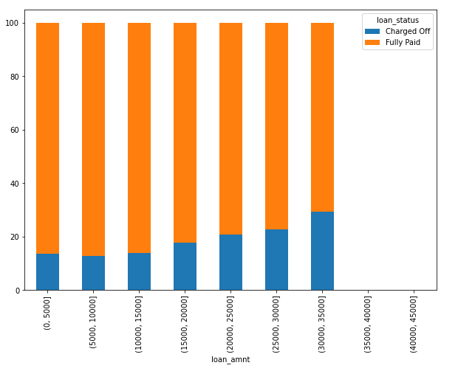
Loan amount vs Loan status
As Loan amount ↑, charged off ↑

Slide 9
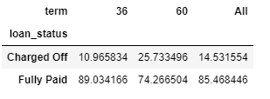
Term vs Loan Status
As Term increase, chance of charged off increases

Slide 10
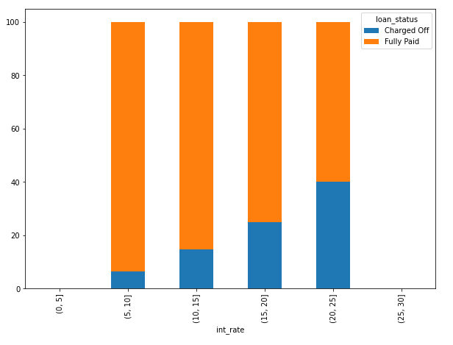
Interest rate vs loan status
As interest rate ↑, charged off ↑

Slide 11
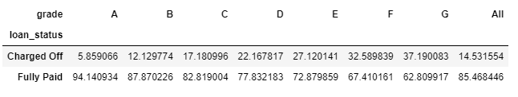
Grade vs loan status
As Grade ↓, Charged off ↑

Slide 12
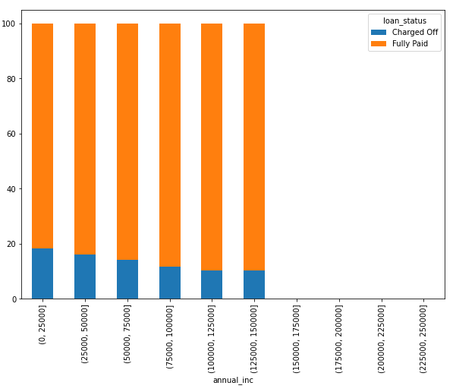
Annual Income vs Loan status
As annual income ↑, charged off ↓

Slide 13
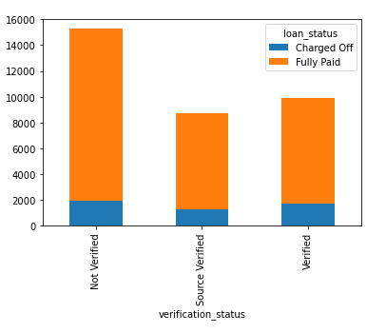
Verification status vs Loan status

Slide 14
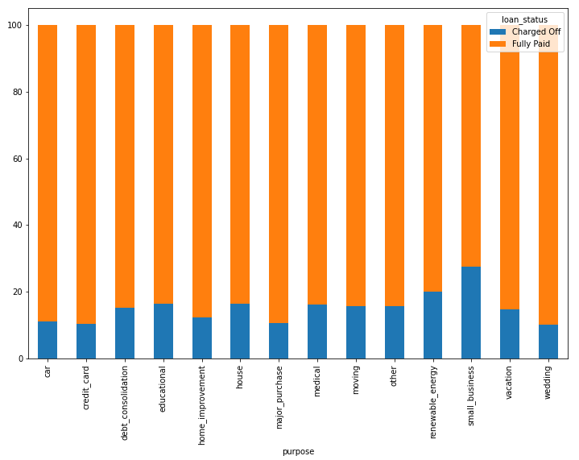
Loan purpose vs Loan status

Slide 15
Thank You

